Slide 1



Flipkart Minutes
DG Online Monitoring, Refilling & Maintenance
Date: 19th Sep, 2026
www.faclon.com

Slide 2
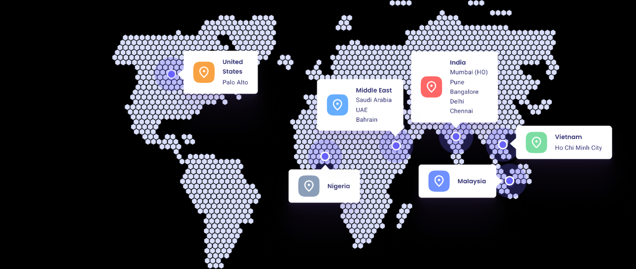

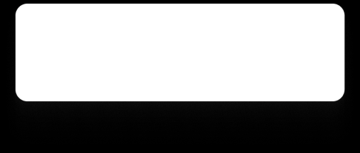
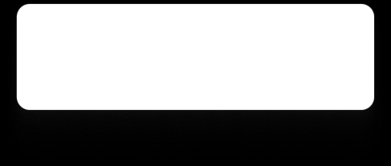




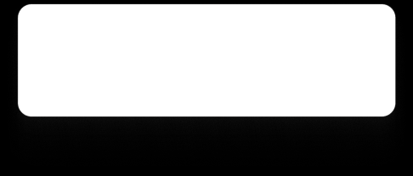

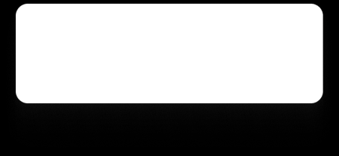



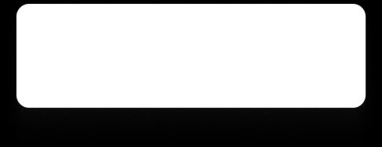
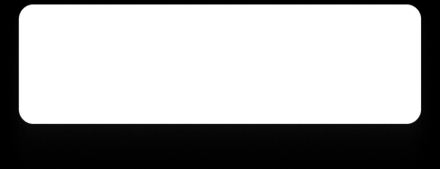
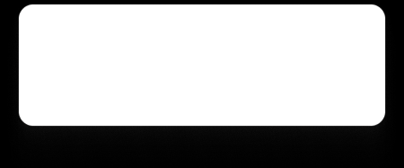

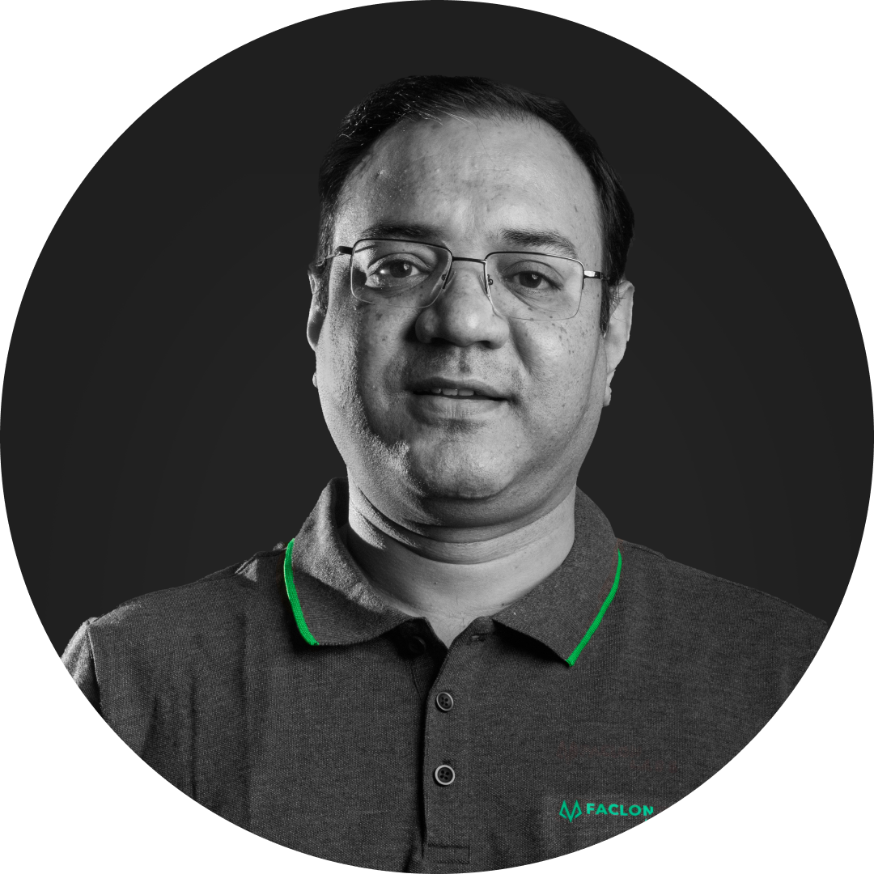




Faclon Labs at a Glance
Leaders in Industrial Data Integration, Visualization, and AI based Optimization
183+
Customers
400+ Deployments
60k+
Assets Connected
5 B+
Data Points Daily
150+
Employees
Rishi Sharma​
Utkarsh Srivastava​
CEO
CTO
B.Tech IIT Bombay
Ex-White Hat Hacker
Backed By
Parth Chaudhary
Vivek Singh​
Sarjan Shah
President of Solution
Chief Data Scientist​
MD, Group Satellite
B. Tech IIT Bombay
B.Tech IIT Kanpur
Archit Naraniwal​
Parag Patil
Jay Kotak
Siddharth Mehra
Chief Sales Officer
Chief Strategic Alliances
B. Tech IIT Bombay
Ex-Wipro, Infosys, RIL
Co-head, Kotak 811
ED, Savita Oil
‹#›

Slide 3






































































Key Customers
Trusted and Ideal digital partner for Industrial setups, commercial setups and OEMs
Automobile &
ancillary
Consumer
Goods
Metals
Cement
Consumer Durables
Chemicals
Energy, Oil & Gas
Pharma
Commercial Infra
OEM tie
-
ups
Partnerships
‹#›

Slide 4
DG ONLINE MONITORING · OVERVIEW
Objective & Business Outcome
Bring every DG onto IOsense, and turn low-fuel and maintenance conditions into vendor work orders that are tracked from creation to completion.
CURRENT PROCEDURE
OBJECTIVE
BUSINESS OUTCOME
01
Fuel level checked physically at the store; no live view across stores
Monitor every DG live: fuel %, litres, running hours, kWh and operating status
Refills triggered by data: one alert, one work order, no duplicates
Refill request raised by phone / message; litres and proof tracked offline
Raise one alert and one refill work order when the level stays below the limit for the waiting time
Every litre on record: quantity, vendor, SPOC and timestamps against one Work Order ID
DG Refilling
Fuel monitoring · vendor refuelling
No consolidated record of litres, vendor and timing per store for reconciliation
Store-to-zone visibility: dashboards and downloads by zone, city, store and vendor
Assign to the primary refilling vendor's SPOC: acknowledge, refuel, enter litres, upload proof, submit
WORKFLOW
Billed from the same record: line items roll into an invoice posted to Oracle Fusion
Low-fuel alert → refill work order → invoice
No live visibility
Draft · for review
02
Service due tracked manually per DG from hour-meter readings and dates
PM due on running-hours limit or fixed period, whichever occurs first — set per DG
PM never missed: work order created automatically when a limit or period is reached
Breakdowns reported by phone; no central view of open jobs or history
Shared visibility: open tickets, PM schedules and repair history for store, central and vendor users
DG Maintenance
Breakdown work order raised in the platform by the store user / maintenance team
Preventive · breakdown
Service history scattered across vendor reports and messages
AMC vendor SPOC acknowledges, carries out maintenance, submits details and proof
Complete service history per DG: trigger, vendor, timestamps and details
WORKFLOW
One platform: same work-order logic and access rules for both workflows
Running hours / period / breakdown → maintenance work order
Manual tracking
Draft · for review
DG Online Monitoring Proposal · Flipkart Minutes
‹#›

Slide 5
01
WORKFLOW 01 · FUEL MONITORING & VENDOR REFILLING
Solution Architecture
What comes in from each DG, what the application decides, and what the vendor and Flipkart users get.
1
INPUTS
2
MONITOR & TRIGGER
3
ASSIGN & EXECUTE
4
OUTPUTS
IoT device + gateway
Faclon supplied · polls the controller
DG Fuel Management Application · IOsense cloud
Mobile-responsive web
Dashboards & views
Store, city and zone by access
Fuel %
Litres
Running hours
Live monitoring
Auto-assignment · primary vendor
Fuel status
Alerts
Work orders
kWh
Status
Fuel, hours, energy and status per DG
Active vendor + SPOC mapped to the DG?
Billing & Oracle Fusion
Line items → invoice → Fusion
Master data
Set up in the application
Low-fuel evaluation
Primary SPOC assigned
Mapping required
Below the limit for the waiting time
Refill charge
Fuel / hours
Zone → City → Store
Vendors & SPOCs
DG › Store › City › Zone › Global
Initial notification
Invoice locked
Low-fuel limits
Email · WhatsApp · in-app, as per access
Alert + refill work order
Transactions & downloads
Filter by zone, city, store, vendor
One alert, one work order, unique ID
Vendor SPOC · web portal
Manual trigger
Store · Central · Super Admin
Acknowledge
Refuel
Enter litres
On-demand refill
Proof
Submit
Audit history
Alerts, actions and transactions
STATUS
Created
Assigned
Acknowledged
Refueling
Submitted
Completed
Duplicate prevention
No valid vendor
Reassignment
Inactive DG
Litres by vendor
Waiting time
Built-in rules & safeguards
as per the SRS
No second alert for the same condition
Work order held; DG flagged for mapping
Moved to another mapped vendor; same ID
No new work orders; history kept
Entered, not derived from IoT readings
Set on the DG data frequency
TBC
DG Online Monitoring Proposal · Flipkart Minutes
‹#›

Slide 6
01
WORKFLOW 01 · FUEL MONITORING & VENDOR REFILLING
How It Works
Three screens: the alert the store sees, the work order the system raises, and the vendor closing it on a phone.
Sample data · illustrative values
1
Low-fuel alert
Store User
2
Work order assigned
System
3
Vendor submits
Vendor SPOC
app.iosense.io/dg/blr-014
app.iosense.io/work-orders/WO-1042
9:41
IOsense · DG Monitoring
Store User
IOsense · Work orders
Central User
My work orders
DG-01 BLR-014 · Bengaluru
WO-1042 Refill
Assigned
Vendor SPOC · FuelCo Logistics
Running
WO-1042 · Refill
DG & store
Trigger
DG-01 · BLR-014, Bengaluru
Fuel level
Estimated fuel
DG-01 · BLR-014
Low fuel · 14 %
Acknowledged
14 %
168 L
Vendor
SPOC
Litres added *
FuelCo Logistics
R. Kumar
380
Refuelling date
12 Sep 2026
Low fuel — below the 20 % limit for 15 minutes
Alert raised · refill work order WO-1042 created
Created
Assigned
Acknowledged
Refueling
Submitted
Completed
Add proof (optional)
invoice.jpg
Raise refill work order
Manual trigger, any time
Notified email · WhatsApp · in-app
Submit refuelling
Next: the vendor SPOC acknowledges and refuels
Fuel drops below the limit. One alert and one refill work order — or the store raises one on demand.
Assigned automatically. Unique work order ID, routed to the mapped vendor SPOC and notified.
Vendor closes it. Acknowledge, refuel, enter litres and submit with proof from a phone.
DG Online Monitoring Proposal · Flipkart Minutes
‹#›

Slide 7
01
WORKFLOW 01 · TRANSACTIONS, BILLING & ORACLE FUSION
Invoicing Walk-through
Every completed work order becomes a billable transaction; the vendor raises one invoice against them and it posts to Oracle Fusion.
Sample data · illustrative values
1
Eligible transactions
Vendor SPOC
2
Invoice raised
Vendor SPOC
3
Locked & posted
System
app.iosense.io/billing/new
app.iosense.io/billing/INV-2026-204
app.iosense.io/billing/INV-2026-204
IOsense · Billing
Vendor SPOC
IOsense · Billing
Vendor SPOC
IOsense · Billing
Central User
Refilling
AMC
Invoice Sep 2026 · 4 work orders
Draft
INV-2026-204
Posted to Fusion
Period: Sep 2026
Method: Per litre
Refilling charges
₹ 4,800
Vendor
Billing period
4 refuelling events
FuelCo Logistics
Sep 2026
WORK ORDER
STORE
LITRES
BASIS
DATE
₹ 1,40,890
Total refill charges
Total fuel charges
WO-1042
BLR-014
380 L
Per litre
12 Sep
Fuel charges
₹ 4,800
₹ 1,40,890
WO-1039
BLR-021
420 L
Per litre
11 Sep
1,460 L × rate per litre
Invoice amount
Submitted
Invoice amount
₹ 1,45,690
₹ 1,45,690
01 Oct 2026 · 11:20
WO-1036
BLR-007
300 L
Per litre
10 Sep
WO-1031
HYD-002
360 L
Per litre
09 Sep
4 work orders locked · cannot be billed again
Already-billed work orders are excluded automatically
Invoice number *
FC/26-27/0412
Attach invoice PDF
Oracle Fusion · API response logged on the audit trail
Review line items
Submit invoice
INV-204.pdf
Vendor picks period and basis. The platform lists unbilled, completed work orders with their billing basis.
One invoice, itemised. Refilling charge per event plus the fuel or running-hours charge, from the vendor's rate card.
Locked and posted. Work orders can never be billed twice; the payload goes to Oracle Fusion via API.
Refilling invoice
Refill charge per refuelling event + fuel or running-hours charge
AMC invoice
Maintenance work orders in the period, at the fixed contract rate per DG
Per Litre Fuel Rate
Running Hours Rate
Fixed Rate AMC
Proposed · to confirm
DG Online Monitoring Proposal · Flipkart Minutes
‹#›

Slide 8
02
WORKFLOW 02 · PREVENTIVE & BREAKDOWN MAINTENANCE
Solution Architecture
Preventive maintenance from running hours or a fixed period, breakdowns from the store — both closed by the AMC vendor.
1
TRIGGERS
2
EVALUATE & CREATE
3
ASSIGN & EXECUTE
4
OUTPUTS
Running hours · IoT
Read from the DG controller
DG Maintenance Workflow · same application
Mobile-responsive web
Shared visibility
Store · central · maintenance · vendor
Limit per DG, e.g. 250 / 500 h
PM evaluation
Auto-assignment · AMC vendor
Breakdown tickets
PM schedules
Hours limit or period reached → PM work order
Active AMC vendor + SPOC mapped?
Repair history
Fixed maintenance period
Configured per DG
Trigger type recorded
Primary SPOC assigned
Mapping required
Service history per DG
Kept with every work order
Whichever occurs first
Value or due date kept on the work order
Running Hours
Scheduled Period
Breakdown
Initial notification
Trigger & value
Vendor & SPOC
Breakdown · manual
Raised by the store / maintenance team
Email · WhatsApp · in-app, as per access
Details & proof
Breakdown work order
Created as soon as it is reported in the platform
AMC vendor SPOC · web portal
Physical failure
Leak
Starting failure
Acknowledge
Carry out
Details + proof
Dashboards & downloads
Open tickets, with filters
Submit
Master data
AMC vendors, SPOCs and PM settings
Action taken · parts replaced · clearance
Audit history
Maintenance alerts and user actions
STATUS
Created
Assigned
Acknowledged
In Progress
Submitted
Completed
Whichever first
Multiple AMC vendors
Same vendor, both roles
Reassignment
Deactivation
Status names
Built-in rules & safeguards
as per the SRS
Hours limit or fixed period, set per DG
Several vendors mapped to one DG or site
Refilling and AMC, same or separate SPOCs
Moved to another mapped vendor; same ID
History kept when a DG or vendor is inactive
Finalised during UI design
DG Online Monitoring Proposal · Flipkart Minutes
‹#›

Slide 9
02
WORKFLOW 02 · PREVENTIVE & BREAKDOWN MAINTENANCE
How It Works
Three screens: the rules set per DG, the work order they raise, and the AMC vendor closing it on a phone.
Sample data · illustrative values
1
Maintenance due
Super Admin
2
Work order raised
System
3
Vendor submits
AMC vendor
app.iosense.io/dg/blr-014/dg-01
app.iosense.io/work-orders/MWO-0217
9:41
IOsense · DG Maintenance
Super Admin
IOsense · Work orders
Central User
My work orders
Preventive maintenance triggers
MWO-0217 Preventive
Assigned
AMC Vendor SPOC · GenServ Engineers
MWO-0217 · Preventive
Running-hours limit
250 h
DG & store
Trigger
DG-01 · BLR-014 · 250 h reached
In progress
Fixed period
90 days
DG-01 · BLR-014
Running hours · 250 h
Action taken *
AMC vendor
SPOC
Oil & filter change
GenServ Engineers
A. Mehta
Hours since last PM
Next PM due in
Parts replaced
244 h
6 h
Oil filter, fuel filter
Created
Assigned
Acknowledged
In progress
Submitted
Completed
Operational clearance given
Add proof
Breakdowns raised in the platform by the store user
service-report.pdf
Preventive maintenance due — 250 h reached
Maintenance work order MWO-0217 created
Submit maintenance
Next: the AMC vendor acknowledges and attends
Rules set once per DG. Running-hours limit or fixed period — whichever comes first raises the work order.
Raised and assigned. Preventive from the trigger, breakdown from the store; routed to the AMC vendor.
Vendor closes it. Action taken, parts replaced, clearance and proof, submitted from a phone.
DG Online Monitoring Proposal · Flipkart Minutes
‹#›

Slide 10
BOTH WORKFLOWS · DEPLOYMENT
Network Architecture
Faclon supplies the field hardware and the cloud; data flows from each DG to IOsense and out to users, vendors and Oracle Fusion.
DARK STORE · PER SITE
IOSENSE CLOUD · FACLON-HOSTED
USERS & FLIPKART SYSTEMS
DG + existing controller
One or more DGs per store, each with its own DG ID
2
Flipkart users
Store · Central · Super Admin · maintenance team
IOsense cloud
Hosted and operated by Faclon Labs; accessed over HTTPS
Controller make TBC
3
Vendor SPOCs
Refilling & AMC vendors · mobile-responsive web
IOsense platform · onboarding, data, dashboards
IoT device + gateway
Supplied, installed and commissioned by Faclon
1
4
Notifications
Email · WhatsApp · in-app
DG Fuel Management & Maintenance Application
RS-485 / Modbus
MQTT / HTTPS push
WhatsApp Business account TBC
Evaluates low-fuel and PM conditions, creates and assigns work orders, sends the initial notification, serves dashboards, transaction views and downloads by role.
Connectivity
4G SIM and data plan from Faclon
5
Oracle Fusion
Invoice payload via API
Faclon supplied
Interface spec TBC
REF
LINK / COMPONENT
WHAT FLOWS
CONFIGURATION TO SET UP
STATUS
1
DG controller → IoT device
Fuel %, litres, running hours, kWh, operating status per DG
Controller make / model and Modbus register map per DG
TBC
2
Gateway → IOsense cloud
Buffered DG data pushed over MQTT / HTTPS on the Faclon 4G SIM
Supplied, installed and commissioned by Faclon
Defined
3
Flipkart & vendor users ↔ app
Dashboards, masters, work orders, vendor submissions, downloads
User list and roles; store, DG, vendor and SPOC masters
TBC
4
Application → notifications
Initial work-order notification
Email sender; WhatsApp Business account and templates
TBC
5
Application → Oracle Fusion
Invoice payload with refill and fuel line items; API response logged
Fusion API spec, authentication, codes and payload
TBC
Hosting
IOsense platform and the application
Faclon-hosted cloud; HTTPS access over the internet
Defined
Data retention
Telemetry, transactions, audit history
IOsense platform data-retention policy
Defined
DG Online Monitoring Proposal · Flipkart Minutes
‹#›

Slide 11
BOTH WORKFLOWS · SCOPE
Scope of Work
What Faclon Labs delivers and what Flipkart provides for the DG monitoring, refilling and maintenance workflows.
Faclon Labs scope design, build, integrate, deploy and support
Flipkart scope inputs, access and infrastructure
Hardware, connectivity & installation
Store master (zone, city, store, email IDs), DG master and the user list with roles
Supply: IoT device and gateway per store, 4G SIM and data — warranty and hardware AMC included
Install & integrate: commissioning at every store; existing DG controller read over RS-485 / Modbus
Refilling and AMC vendor list, SPOC contacts, vendor-to-DG mapping and rate cards
DG monitoring on IOsense
Live DG views: fuel level, volume, running hours, kWh and status; store, city and zone views
Low-fuel limits, waiting time and PM settings (running-hours limit / fixed period) per DG
Workflow 01 · Fuel management & vendor refilling
Masters & settings: store, DG, vendor & SPOC masters; low-fuel limits; waiting time; rate cards
Refill cycle: alert → work order → assignment → vendor portal → completion, with audit history
Site access to each store and DG for installation and commissioning
Workflow 02 · Preventive & breakdown maintenance
PM & breakdown: triggers per DG; work order to the AMC vendor; details and proof; shared history
Power supply and mounting space for the gateway; store network access where used
Billing, Oracle Fusion & services
Oracle Fusion interface specification, authentication and credentials
Billing to Fusion: line items, eligible transactions, invoice upload, locking, posting to Oracle Fusion
Also included: notifications, dashboards and downloads · SOP · training · UAT · go-live support
Optional scope · automated report scheduling and distribution — schedule and recipients to be finalised
WhatsApp Business account and email sender for the work-order notifications
Responsibility to be agreed
Vendor SPOC account creation and onboarding · WhatsApp message-template approval
DG Online Monitoring Proposal · Flipkart Minutes
‹#›

Slide 12
BOTH WORKFLOWS · DELIVERABLES
Software Deliverables
One application on the IOsense cloud, delivered as six capabilities.
DG Fuel Management & Maintenance Application
Mobile-responsive web
IOsense cloud
01
02
03
DG Monitoring on IOsense
Alerts & Work Orders
Vendor Portal
Every DG live — fuel level, volume, running hours, energy and operating status, from store to zone.
Low fuel, maintenance due and breakdown raise a work order automatically and assign it to the mapped vendor.
Vendor SPOCs acknowledge, execute and submit litres or maintenance details with proof, from any device.
04
05
06
Billing & Oracle Fusion
Dashboards & Reports
Access Control & Audit
Line items per transaction, invoice with upload and locking, posted to Oracle Fusion over the API.
Operational and financial views, filters and CSV / Excel downloads, limited to each user's access.
Store, central, vendor, maintenance and super-admin roles, with a full audit history of every action.
Services included
User manual / SOP
Operator & vendor training
UAT and go-live support
Post go-live support
DG Online Monitoring Proposal · Flipkart Minutes
‹#›

Slide 13
BOTH WORKFLOWS · PLAN
Implementation Milestones
From kick-off to go-live — hardware, application, billing and Fusion; the week-by-week plan follows on the next slide.
01–02
DG Online Monitoring
Refilling · Maintenance
MILESTONE 1
MILESTONE 2
MILESTONE 3
MILESTONE 4
MILESTONE 5
MILESTONE 6
Kick-off & requirement sign-off
Hardware supply & installation
Application development
Configuration & integration
UAT
Go-live & handover
End-to-end refill, maintenance and billing cycles with store, central and vendor users
Go-live across stores, user manual / SOP and training; post go-live support begins
Scope, masters, thresholds, PM settings, billing rates and the Fusion interface signed off
IoT devices, gateways and SIMs delivered, installed and commissioned; DG controllers integrated
Masters, alert engine, work orders, vendor portal, billing engine and dashboards
Masters loaded, notifications connected and the Oracle Fusion interface integrated
APPLICATION
DG Fuel Management & Maintenance Application on the IOsense cloud
Signed-off SRS
DGs live on IOsense
Build complete
System configured
UAT sign-off
Live + handover
M1
M2
M3
M4
M5
M6
SRS sign-off
Site access
Clarifications on rules
Vendor & SPOC list
Users for UAT
Rollout store list
Inputs needed from Flipkart
at each milestone, so the plan holds
Store & DG masters
Power & mounting
WhatsApp / email setup
Test stores / DGs
Go-live schedule
Limits & PM settings
Store & DG list
Fusion API spec
DG Online Monitoring Proposal · Flipkart Minutes
‹#›

Slide 14
BOTH WORKFLOWS · PLAN
Project Delivery Schedule
Indicative plan from kick-off. Hardware supply and store-by-store installation run alongside the application build.
Objective
Application Design & Project Kickoff
Hardware Supply
Installation and Commissioning
Application Development
Configuration & Integration
UAT & Training
Go-live, Handover & Hypercare
Total delivery time
DG Online Monitoring
Refilling · Maintenance
1 week
6 weeks
12 weeks
8 weeks
12 weeks
3 weeks
1 week
22 weeks
Project Onboarding Phase
Kick-off, hardware supply and installation
Implementation Phase
Application build and Fusion integration
Go-live Phase
UAT, training, handover and hypercare
WEEK
1–2
3–4
5–6
7–8
9–10
11–12
13–14
15–16
17–18
19–20
21–22
Application Design & Project Kickoff
Kick Off
Hardware Supply
IoT Devices and Gateway
Installation and Commissioning
Installation and Commissioning of Hardware at each store
Application Development
DG Fuel Monitoring and Maintenance Application
Configuration & Integration
Configuration and Integration with Fusion
UAT & Training
UAT and user training
Go-live, Handover & Hypercare
Go Live
Basis: indicative durations from kick-off. Installation and commissioning run store by store and depend on the final store count; Fusion integration depends on the specification from Flipkart.
DG Online Monitoring Proposal · Flipkart Minutes
‹#›

Slide 15
BOTH WORKFLOWS · COMMERCIALS
Commercials
Commercial summary including hardware, software, billing and Oracle Fusion. Amounts to be filled in.
# | LINE ITEM | DESCRIPTION | TYPE | AMOUNT
01 | Hardware supply & installation | IoT device and gateway per store, mounting and accessories; installation, commissioning and integration to the existing DG controller at each store — warranty included | One-time
02 | Software development & implementation | DG Fuel Management & Maintenance Application: monitoring, alerts, work orders, vendor portal, vendor billing and Oracle Fusion integration; deployment on the IOsense cloud | One-time
03 | IOsense platform licence | Cloud platform licence for the DG monitoring and workflow application — licence basis (per DG / per store) TBC | Annual
04 | Connectivity | 4G SIM and data plan per store gateway | Annual
05 | Annual support / AMC | Software support and hardware AMC after the warranty period | Annual
06 | Optional · Automated reports | Scheduled report generation and distribution — schedule and recipients to be finalised | One-time · optional
One-time total
Hardware supply & installation + Software development & implementation
Amount
Annual recurring total
IOsense platform licence + Connectivity + Annual support / AMC
Amount
Hardware quantities to be confirmed against the final store and DG count; existing DG controllers are read, not replaced.
Taxes, payment terms and validity to be stated with the amounts.
Warranty period, hardware AMC start, licence basis and post go-live support duration to be confirmed.
DG Online Monitoring Proposal · Flipkart Minutes
‹#›

Slide 16
BOTH WORKFLOWS · NEXT STEPS
Open Points to Confirm
Items to close with Flipkart before requirement sign-off. Tags show the workflow each point applies to: 01 refilling, 02 maintenance.
Hardware & site
Business rules
01
DG controller make / model, protocol and Modbus register map per DG — for the gateway integration
01
02
05
Low-fuel limits per level and the waiting time before an alert is raised
01
02
Store and DG count for the rollout — drives hardware quantities, licence basis and installation plan
06
PM running-hours limits and fixed maintenance periods per DG (e.g. 250 / 500 h)
02
01
02
07
Work-order status names — to be finalised during UI design
01
02
03
Site readiness at each store: power supply, mounting space and network / signal availability
01
02
04
Estimated fuel volume (L): read from the controller or derived on IOsense from tank capacity
01
Users, notifications & plan
11
User list and roles; vendor and SPOC onboarding — who creates and maintains the accounts
01
02
Billing & Oracle Fusion
12
WhatsApp Business account, message templates and email sender for the initial notification
01
02
08
Fusion interface specification: endpoint, authentication, codes and payload format
01
13
Warranty period, hardware AMC start, post go-live support duration and schedule confirmation
01
02
09
Rate cards: diesel rate, running-hours rate and vendor refilling charges; billing type per site
01
10
AMC vendor billing (Fixed Rate AMC in Flipkart’s version) — not covered by the SRS billing flow
02
Proposed next steps
Walk-through of this proposal with Flipkart
Close the open points and sign off the SRS
Site survey and hardware order for the first stores
Kick-off and start of the delivery schedule
1
2
3
4
DG Online Monitoring Proposal · Flipkart Minutes
‹#›

